Slide 1
23. Minimum Spanning Tree, Directed Graphs, Topological Sort
ECE 309
Dr. James Tuck

Slide 2
Objectives
Define minimum spanning tree and some problems it can be used to solve.
Define directed graph and give an example.
Explain how to represent a directed graph in code.
Define topological sort and explain how it can be used.
Implement topological sort using a depth-first search.

Slide 3
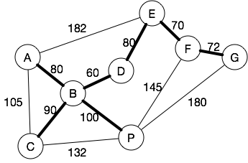
Minimum Spanning Tree
A utility company needs to lay down fiber optic cables to potential customers. Where should it put them?
The weight on each edge is the normalized cost of installing the cable.
Total cost of putting a cable on all edges: 1296
Total cost of only putting them on the bold edges: 552

Slide 4
Minimum Spanning Tree (MST)
A graph's minimum spanning tree is a subset of the graph's edges that connect all vertices in the graph together with the minimum sum of edge weights.
The graph must be weighted and connected. A connected graph contains a path (not edge) between every pair of vertices.

Slide 5
Finding the Minimum Spanning Tree
Informal algorithm:
Repeat until all nodes are connected:
Pick the edge with the smallest weight remaining such that the two nodes it connects are not already connected.
Add the edge to the set of MST edges.

Slide 6
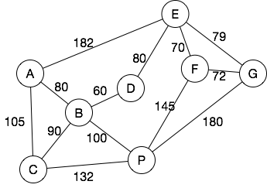
Minimum spanning tree example
Next minimum edge | Nodes Connected? | Vertex Sets

Slide 7
Minimum spanning tree example
Next minimum edge | Nodes Connected? | Vertex Sets
B-D (60) | No | {B,D}
E-F (70) | No | {B,D}, {E,F}
F-G (72) | No | {B,D},{E,F,G}
E-G (79) | Yes | No change
A-B (80) | No | {A,B,D},{E,F,G}
D-E (80) | No | {A,B,D,E,F,G}
B-C (90) | No | {A,B,C,D,E,F,G}
B-P (100) | No | {A,B,C,D,E,F,G,P}

Slide 8
Kruskal’s MST Algorithm
KruskalsMinimumSpanningTree(graph) {
edgeList = list containing all edges from graph
vertexSets = collection of vertex sets, empty initially
for each vertex V in graph
Add new set containing only V to vertexSets
resultList = new, empty set of edges
while (vertexSets->length > 1 && edgeList->length > 0) {
nextEdge = remove edge with minimum weight from edgeList
vSet1 = set in vertexSets containing nextEdge->vertex1
vSet2 = set in vertexSets containing nextEdge->vertex2
if (vSet1 != vSet2) {
Add nextEdge to resultList
Remove vSet1 and vSet2 from vertexSets
merged = union(vSet1, vSet2)
Add merged to vertexSets
}
}
return resultList
}

Slide 9
Implement the MST algorithm in C++
Some implementation notes:
For the vertexSets, we can just use Lists of integers.
  Union on lists can be fast!
For the edge lists, we need a new list class
  It would be nice if this can be sorted.
  We could use an edge list for our adjacency lists

Slide 10
Directed Graphs
A directed graph, or digraph, consists of vertices connected by directed edges.
A directed edge is a connection between a starting vertex and a terminating vertex.
The start vertex is sometimes called the source.
The terminating vertex is sometimes called the destination.
Usually drawn as an arrow, pointing from source to destination.

Slide 11
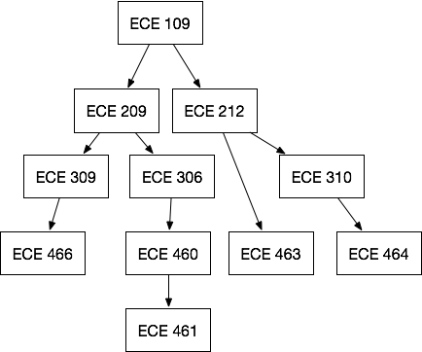
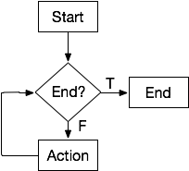
Examples of directed graphs

Slide 12
Adjacency in a directed graph
Node Y is adjacent to node X if there is an edge from X to Y.
209 is adjacent to 109.
463 is adjacent to 212.
464 is adjacent to 310.
109 is not adjacent to 209.
463 is not adjacent to 464.

Slide 13
Representation of directed graphs
Adjacency lists and matrices are still effective representations
Y adjacent-to X does not imply X adjacent-to Y.
We only connect an edge in one direction.
Note: pointers are also a good way to represent an edge, since they are inherently directional.

Slide 14
Paths and cycles in directed graphs
A path is a sequence of directed edges leading from a source (starting) vertex to a destination (ending) vertex.
A cycle is a path that starts and ends at the same vertex.

Slide 15
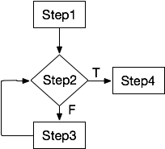
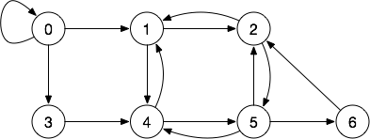
Examples of cycles
Cycles:
2,5,6.2
1,2,5,4,1
1,4,5,2,1
0,0
Cycle: Step2,Step3,Step2

Slide 16
Two kinds of directed graphs
Cyclic: At least one cycle is present in the graph.
Flowcharts are cyclic directed graphs (e.g. they have loops)
Acyclic: No cycles are present in the graph
Often abbreviated DAG: directed acyclic graph
Important class of graphs that show up everywhere!
Useful in scheduling problems, partial orderings

Slide 17
Directed Acyclic Graphs (DAGs)
A directed graph with no cycles. Useful for things like:
Curriculums
Recipes
Gantt Charts
Schedules

Slide 18
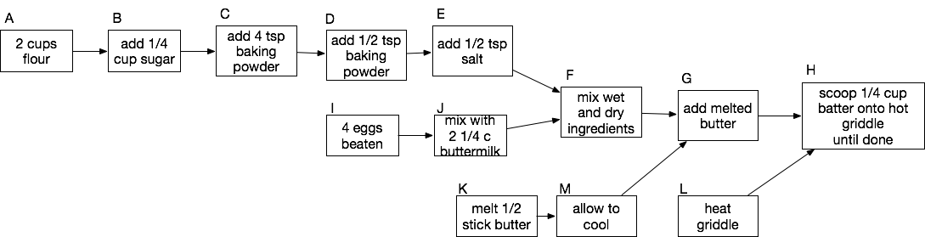
DAG for making pancakes
In what order should we perform
these steps to make pancakes?

Slide 19
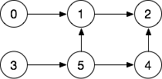
Topological sort
Topological sort orders the nodes in a DAG such that the source of an edge occurs before the destination of the edge.
0 or 3 can come first
5 must come before 1
4 must come before 2
1 must come before 2
Topological sorts: 0,3,5,4,1,2
3,5,4,0,1,2

Slide 20
Topological sort
Topological sort: K, A, B, C, D, E, L, I, J, F, M, G, H
Or: A, B, C, D, E, I, J, F, K, M, G, L, H

Slide 21
Implementations for topological sort
Approach 1 (used in zyBook):
  Keep track of the incoming edges to a node.
  Once all of a node’s incoming edges are scheduled, schedule it.
Approach 2:
  Reverse post-order DFS traversal.

Slide 22
Post-order DFS traversal
In DFS, we can visit a node before its adjacent nodes or afterwards:
pre-order: visit a node before its adjacent nodes
post-order: visit adjacent nodes first, then the node

Slide 23
Pre-order versus Post-order DFS
RecursiveDFS(node) {
if ( node is not in visitedSet ) {
Add node to visitedSet;
preOrderVisit(node);
for each vertex adjV adjacent to node {
RecursiveDFS(adjV);
}
postOrderVisit(node);
}
}

Slide 24
Example: pre-order vs. post-order
Pre-order start at 0: 0, 1, 2, 3, 5, 4
Post-order start at 0: 2, 1, 0, 4, 5, 3
Reverse post-order: 3, 5, 4, 0, 1, 2
Post-order start at 3: 2, 4, 1, 5, 3, 0
Reverse post-order: 0, 3, 5, 1, 4, 2

Slide 25
Why does this work?
Post-order guarantees that all adjacent nodes of n have already been visited before visiting n.
The reverse post-order means that a node is ordered before all of its adjacent nodes. That’s what we want!

Slide 26
One more addition to DFS algorithm
DFS starts at a single node.
But, if we start at 0, we never reach 3, and vice versa.
We must call DFS algorithm on all nodes with no incoming edges.
Node 0 and 3 in this graph.

Slide 27
Topological Sort Pseudocode
TopologicalSort(graph) {
list = find all nodes in graph with no incoming edges
sortedList = empty list
for each node in list {
RecursiveDFS(node);
}
}
RecursiveDFS(node) {
if ( node is not in visitedSet ) {
Add node to visitedSet;
for each vertex adjV adjacent to node {
RecursiveDFS(adjV);
}
insert node at head of sortedList
}
}

Slide 28
Implement topological sort in C++
Use the class-based implementation and override the visit function to collect the ordered nodes.

Slide 29
Summary
Minimum spanning tree is useful for selecting a subset of edges from a graph that ensures all nodes are still connected.
Topological sort and minimum spanning tree are both efficient algorithms on graphs.
Topological sort is often used to produce a single order of nodes that obeys all edge ordering constraints

Slide 30
References
1. ZyBook on Data Structures, chapters 19.7, 19.11, and 19.12

Slide 31
MST
void MinimumSpanningTree(Graph &g, EdgeList &resultList) {
mst_helper nodes[g.getNumNodes()];
EdgeList &eList = getEdgeList(g);
for (int i = 0; i < g.getNumNodes(); i++)
nodes[i].vertexSet->append(i);
EdgeList::iterator ei;
int numNodes = g.getNumNodes();
for (ei = eList.begin(); numNodes > 0 && !ei.end(); ei.increment()) {
Edge e = ei.getEdge();
if (nodes[e.from].vertexSet != nodes[e.to].vertexSet) {
// not yet connected!
resultList.append(e);
List *to = nodes[e.to].vertexSet;
List::iterator it = to->begin();
while (!it.end()) {
nodes[it.getItem()].vertexSet = nodes[e.from].vertexSet;
it.increment();
}
nodes[e.from].vertexSet->append(*to);
delete to;
numNodes--;
}
}
}

